Slide 1
Intro to Eau d’coli
presented by MIT’s 2006 iGEM team
@ the Jamboree, 2006
Introduction by Dr. Natalie Kuldell

Slide 2
System level description (initial)
Input
Black box functions
Output

Slide 3
System level description (initial)
Precursor compound
Black box functions
Smell

Slide 4
Device level description (initial)
Precursor compound
WGD
and
Smell
BGD
WGD: Wintergreen Generating Device
Device List !!
BGD: Banana Generating Device

Slide 5
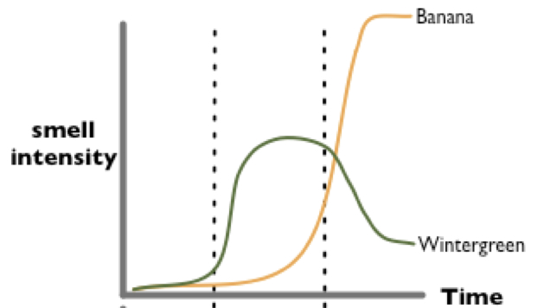
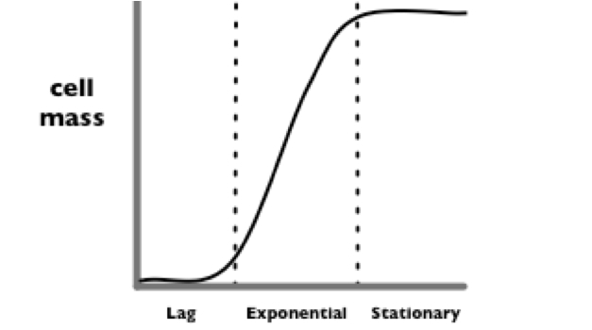
System level description (revised)
WGD
WGD
Cell Growth
and
Smell
BGD

Slide 6
Device level description (revised)
saGD
WGD
Cell Growth
and
Smell
iaGD
BGD
Device List !!
WGD: Wintergreen Generating Device
BGD: Banana Generating Device
saGD: salicylic acid Gen Dev
iaGD: isoamyl alcohol Gen Dev

Slide 7
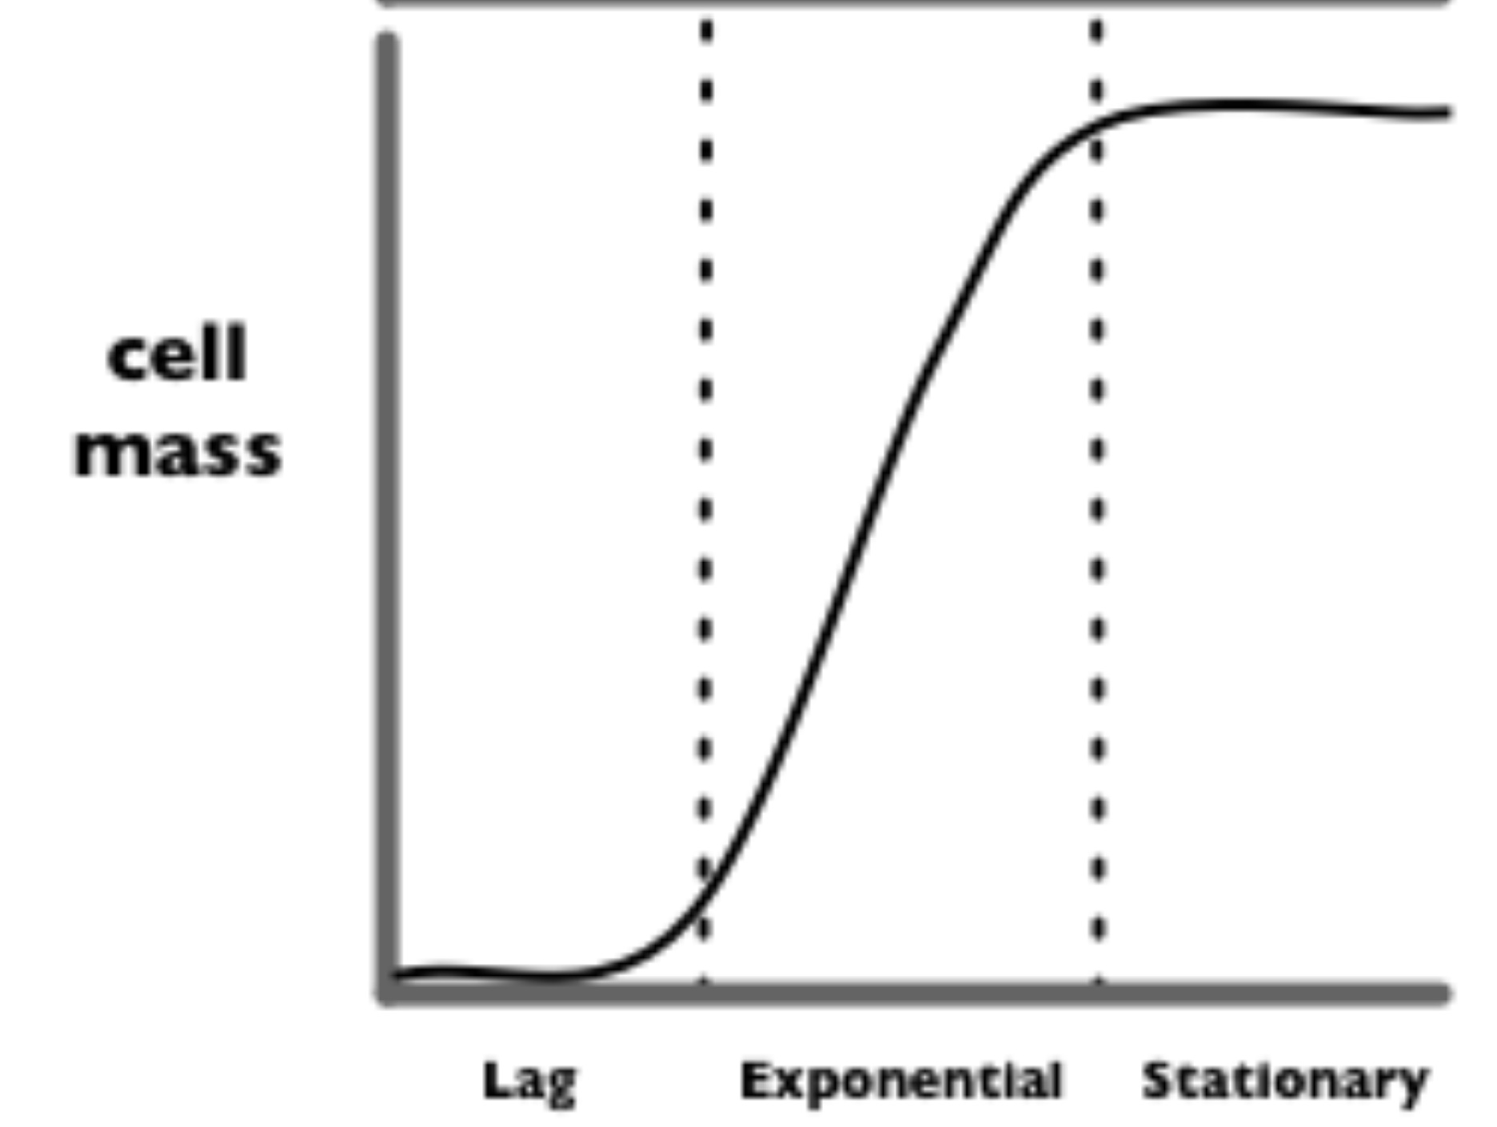
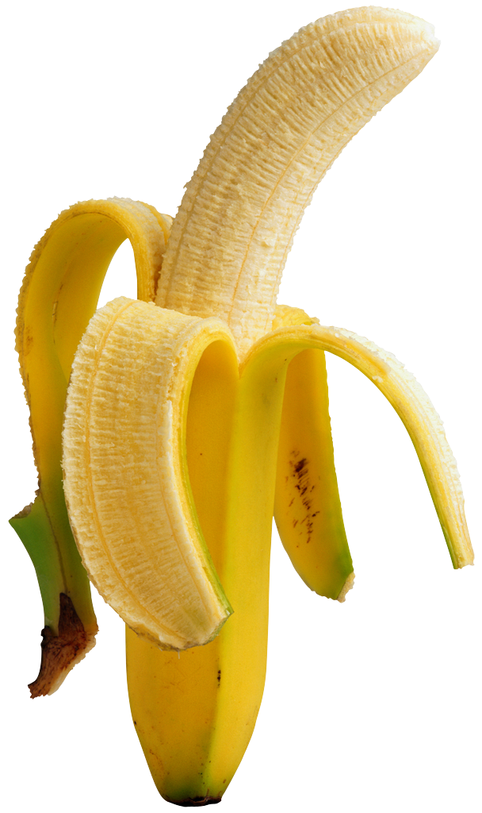
Parts specification for stationary phase banana smell
“stationary”
BGD
cell density
“log”
OsmY is a promoter that is only active during stationary phase
“lag”
time

Slide 8
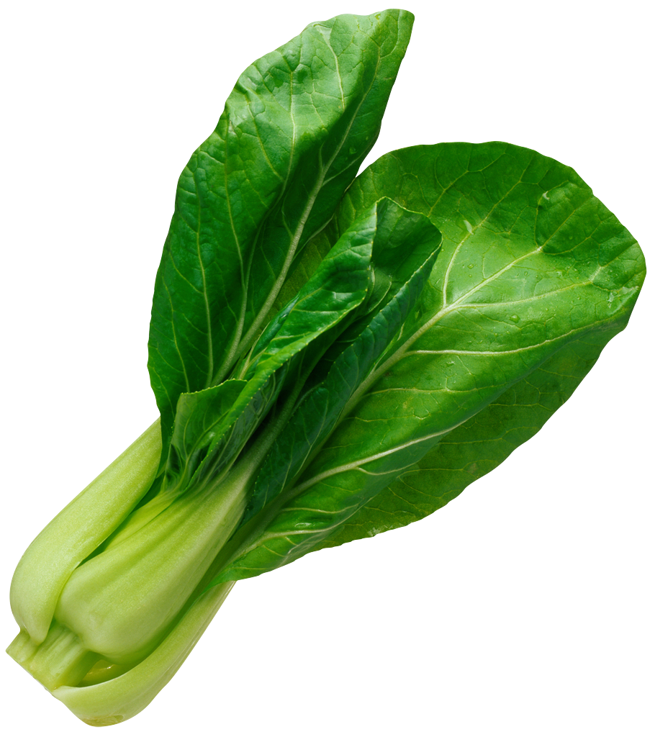
Parts specification for log phase wintergreen smell
“stationary”
cell density
“log”
WGD
“lag”
 | Stationary | Log
OsmY | 1 | 0
OsmY + inverter | 0 | 1
time

Slide 9
One last modification to the E. coli chassis
“stationary”
cell density
“log”
saGD
WGD
“lag”
iaGD
BGD
time
eliminate natural indole production

Slide 10
“Eau d’coli”
“stationary”
cell density
“log”
saGD
WGD
“lag”
iaGD
BGD
time
Notes:
http://parts.mit.edu/movies/iGEM2006_MIT.mov

Slide 11
Intro to Eau d’coli
presented by MIT’s 2006 iGEM team
@ the Jamboree, 2006
Introduction by Dr. Natalie Kuldell

